Slide 1

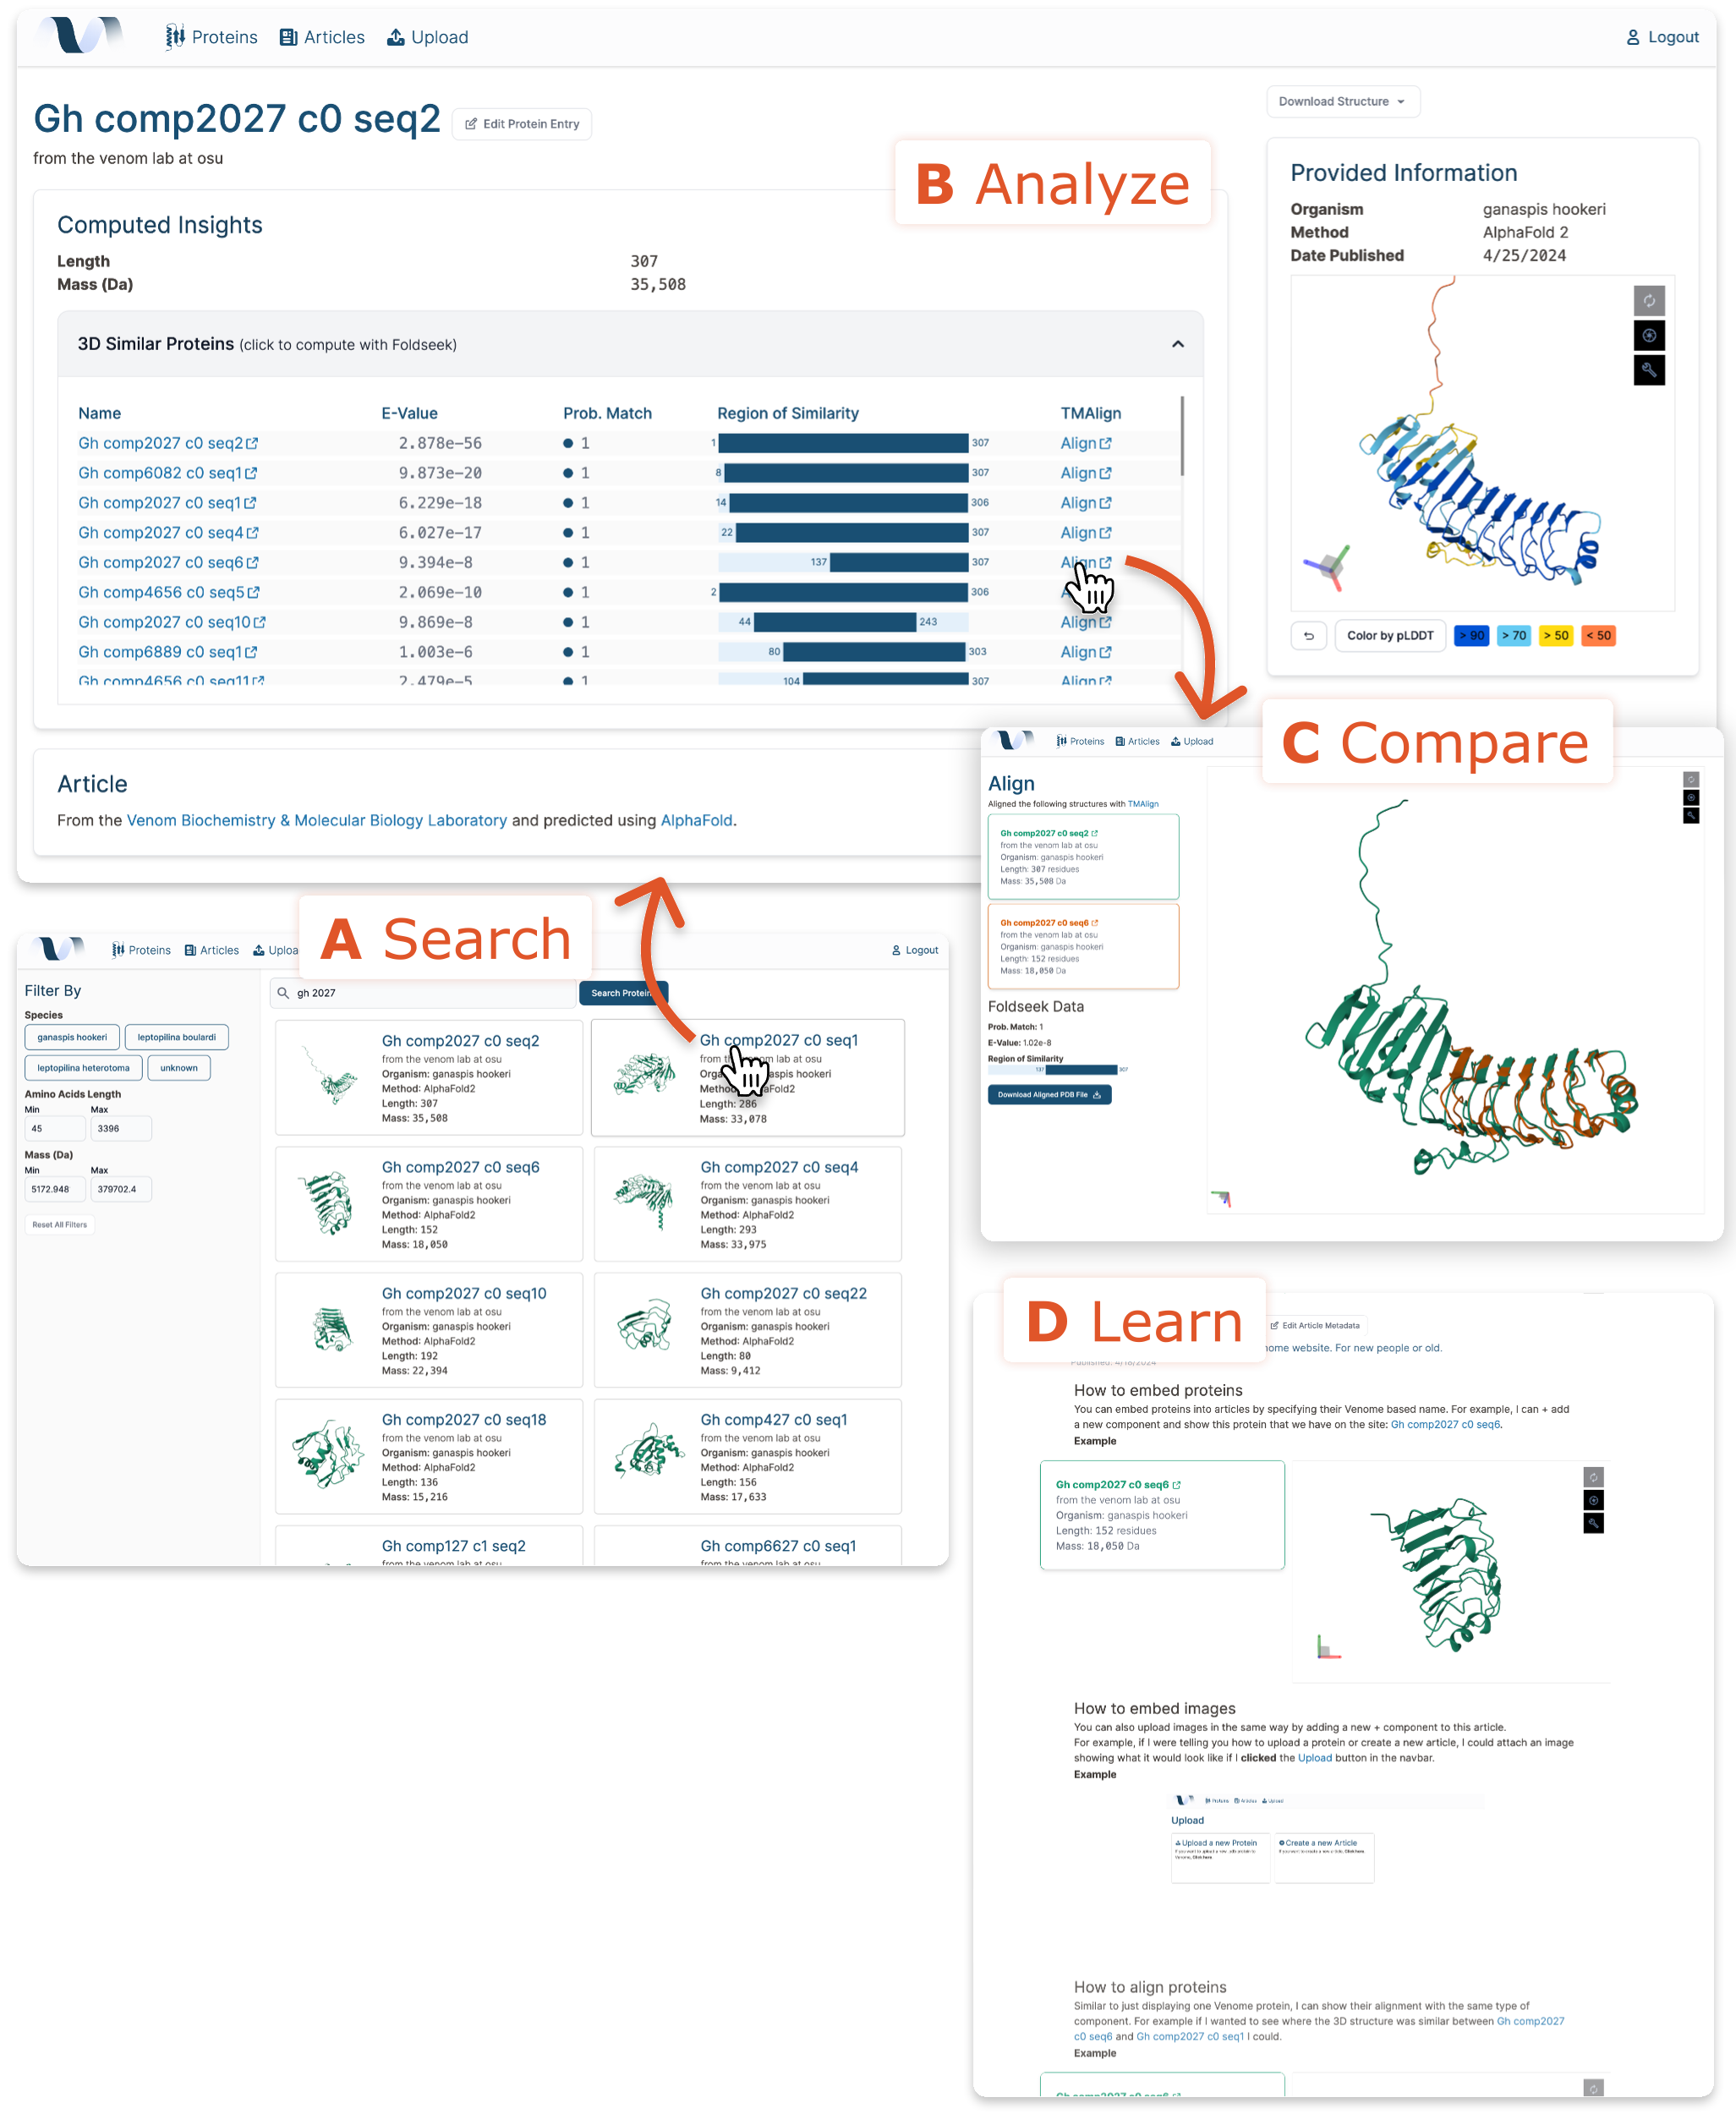



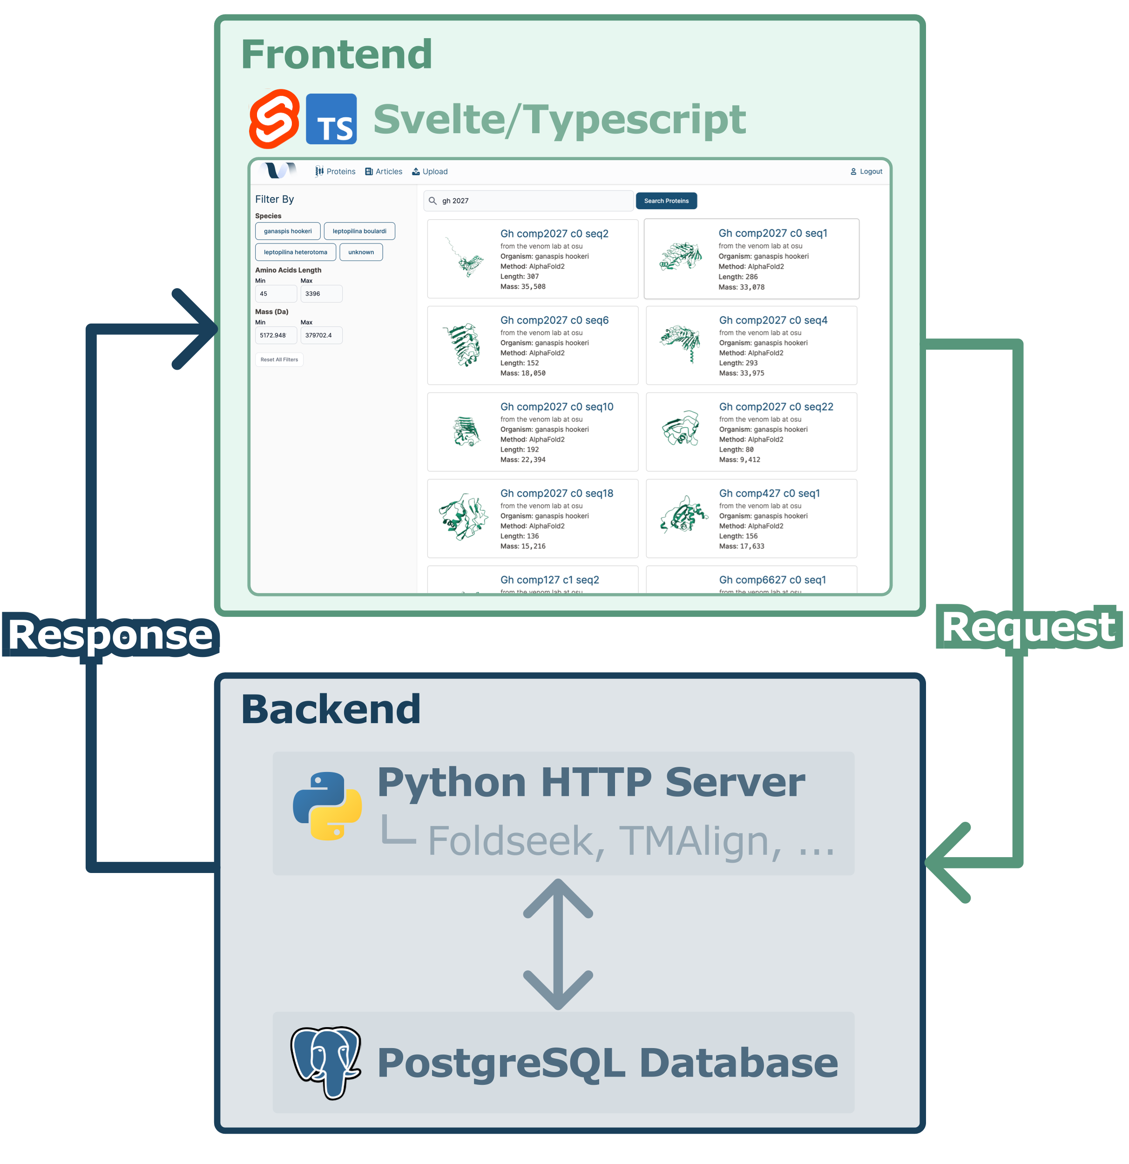


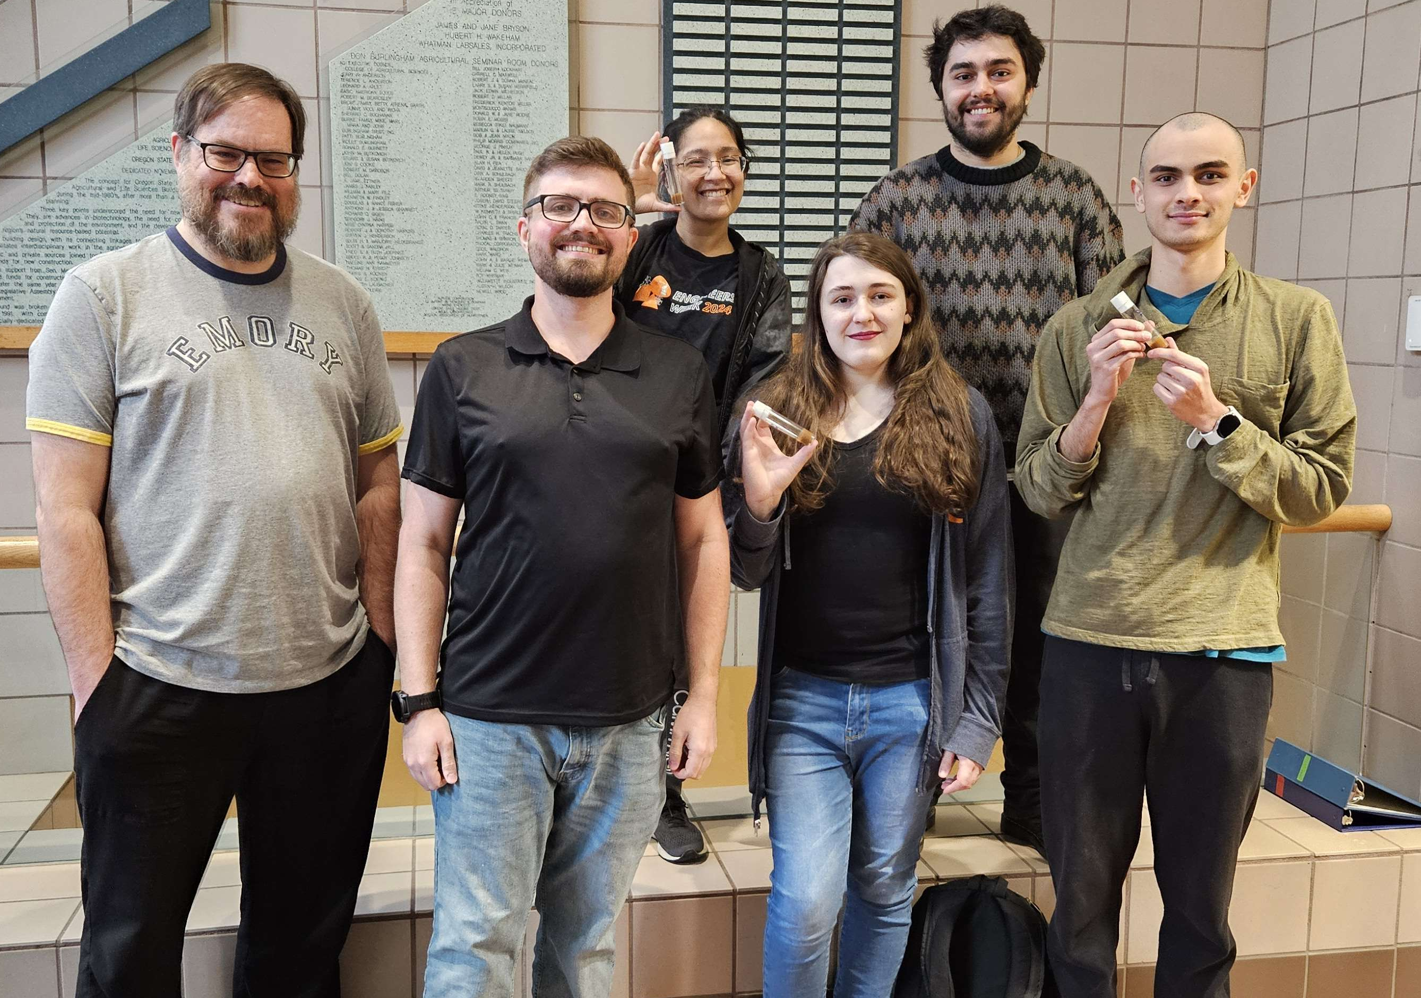
CS.094
Accelerating Venom protein research
The Unknown Venome
The Team
A website to store and analyze venom proteins
Capstone Group
The Problem
Researchers at OSU's Venom Biochemistry Lab (Venom Lab) need an easy way to store, compare, analyze, and share their venom proteins.
Our Solution
A public-facing website with protein entries and articles to share the Venom Lab’s research.
A database to support over 400 venom proteins with filtering and search.
Integration with standard protein visualization and analysis tools such as Mol*, Foldseek and TM-Align.
Donald Bertucci
bertuccd@oregonstate.edu
Ansen Garvin
garvina@oregonstate.edu
Cora Bailey
bailecoo@oregonstate.edu
Amanda Sinha
sinhaam@oregonstate.edu
OSU Venom Biochemistry Lab
Michael Youkhateh
youkhatm@oregonstate.edu
Dr. Nathan Mortimer
nathan.mortimer@oregonstate.edu
Figure 1: High-level overview of our client-server architecture for the Venome site.
Figure 2: With Venome, the Venom Lab can upload their proteins, (A) search and filter for proteins, (B) visualize and analyze 3D structures, and (C) compare between them. Website users can (D) learn about the site or the Lab’s research with interactive articles.
Figure 3: Venome Team picture (including parasitoid wasps in the tubes).

